Slide 1
COMMUNICATION SKILLS
INTRODUCTION

Slide 2
AIM OF COMMUNICATION SKILLS
Helping learners understand the conceptual framework of communication
Introducing learners to different communication media.
Helping learners acquire practical communication skills.

Slide 3
Learning outcomes
By the end of this course, students should be able to:
Understand the conceptual framework of communication
Explain the importance of effective communication.
Acquire practical communication skills.
Communicate effectively using different media
Open their accounts on electronic media used for communication like Emails, Twitter and LinkedIn.

Slide 4
References/ reading materials
1. Oakley, B., Felder, R. M., Brent, R., and Elhajj, I. “Turning student groups into effective teams.” Journal of student-centred Learning, Vol. 2, No. 1, 2004, pp. 9-34.
2. Brown, Michele & Gyles Brandreth. How to Interview and be Interviewed. London: Sheldon Press, 1994
3. Kroehnert, Gary. Basic Presentation Skills. Sidney: McGraw Hill, 2010.
4. Moore, Ninja-Jo, et al. Nonverbal Communication: Studies and Applications. New York: Oxford University Press, 2010.

Slide 5

INTRODUCTION TO COMMUNICATION SKILLS

Slide 6
What is communication
In simple words we can say that “just to convey the message”
If we go in more detail we can say that “ communication is the process of sending (A B) & Receiving (B A) Messages.
Theodorson ( 1969): Defines communication as the transmission of information , ideas, attitudes, or emotions from one person or group to another or others primarily through symbols.
Osgood et al. (1957) There is communication wherever one system or source influences another, by manipulation of alternative symbols transmitted over the channel

Slide 7
What is communication cont’d
Communication is simply the act of transferring information from one place to another. This may be vocally (using voice), written (using printed or digital media such as books, magazines, websites or emails), visually (using logos, maps, charts or graphs) or non-verbally (using body language, gestures and the tone and pitch of voice). How well this information is transmitted and received is a measure of whether your communication skills are good.

Slide 8
Importance of communication
Communication skills not just handy; they are critical tools for success
Important for survival in real world environment
Critical for propagation of knowledge and development; Managing change/ conflicts effectively
Communication skills are the building blocks of academic life and career
Communication skills occupies central position in a student's’ life and that of practicing professional
Basic skills for survival at university, higher learning and in the career world.

Slide 9
Importance of communication skills- cont’d
Useful in training of professionals and acquisition of:
-Cognitive skills(mental skills)
- Psychomotor( manual or physical skills)
-(Technical) skills
-Social –( Communication skills).
All professionals need more than specialized knowledge

Slide 10
Categories of communication
Conscious and Intentional
Nonverbal
Verbal
Unconscious and Unintentional
Nonverbal
Verbal

Slide 11
Basic communication model
For communication to exit there must be at least four elements.
1.A sender / encoder
2.A receiver / Decoder
3.Message
4.Channel/Medium
Speaker encoding message decoding listener
In successful communication
sent =received

Slide 12
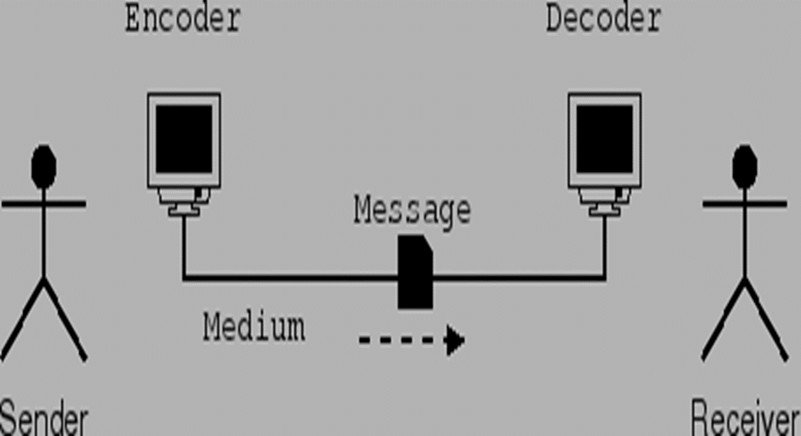
Basic communication model- cont’d

Slide 13
Definitions
Sender: The person sending message or the person who initiates communication
Encoder/ sender: Encodes the message
Encoding: the process of transferring the information you want to communicate into a form that can be sent and correctly decoded at the other end
Decoder / receiver: Decodes the message
Decoding: the process where the message is interpreted for its content.
Receiver: The person receiving the message

Slide 14
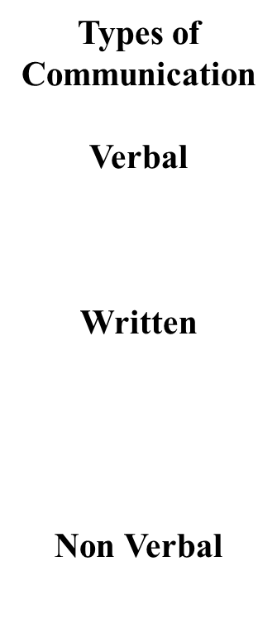
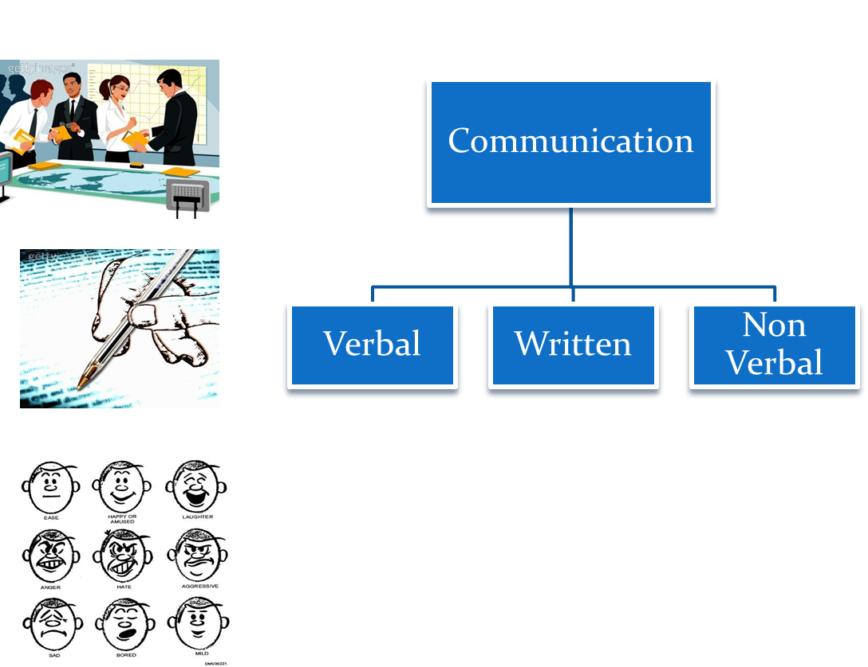

Slide 15
Communication types
Verbal Communication
Spoken verbal communication, relies on both words, visual aids and non-verbal elements to support the conveyance of the meaning. Includes discussion, speeches, presentations, interpersonal communication and many other varieties.
Non Verbal Communication (Body language)
Facial expressions, gestures, paralanguage, body language, distance, eye contact, touch, and appearance
Written communication
Letters, blogs, posters,news papers etc

Slide 16
Communication process
In case of Verbal type of Communication, look out for the following:
Verbal: What you say i.e. the message
Vocal: How you say i.e. Music or your voice
Visual: How you seem and who you are
Most powerful element of communication is:
Visual
! Give importance to visual self, as much as the knowledge and experience.

Slide 17
Communication process -cont’d
Definition
A series of actions or steps taken in order to successfully communicate.
It involves several components such as the sender of the communication, the actual message being sent, the encoding of the message, the receiver and the decoding of the message.

Slide 18
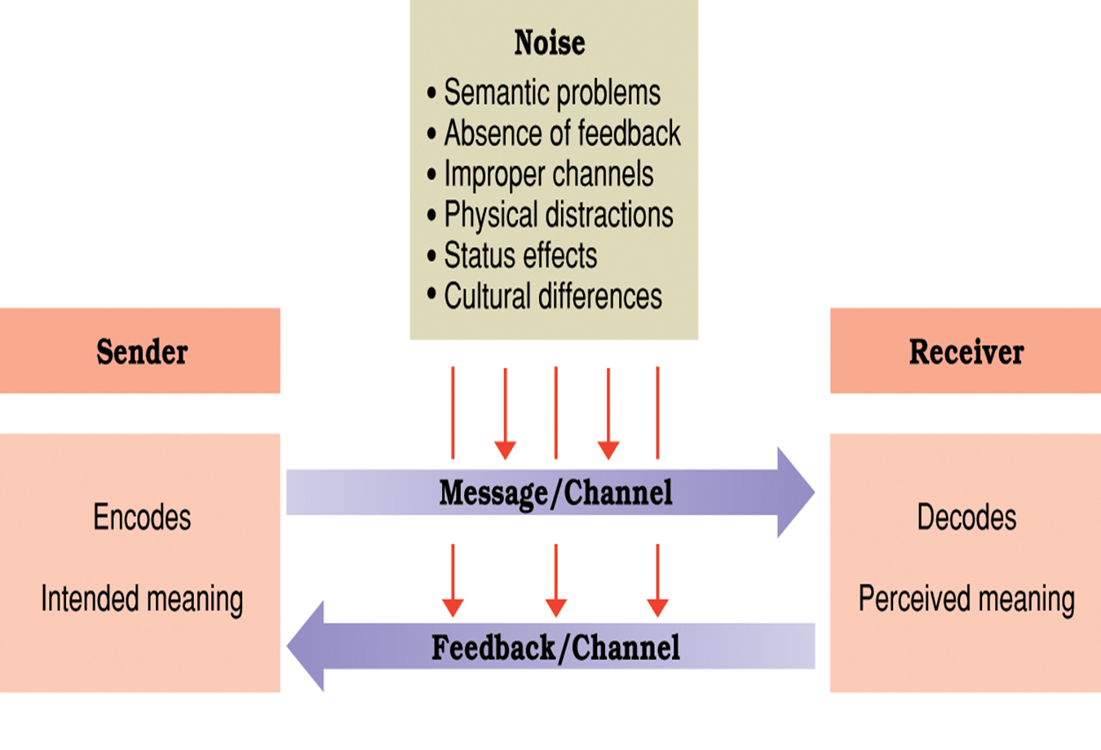
Diagram-communication process

Slide 19


